Slide 1
EE351 Microcomputer and Microsystems
2025秋 EE351《微机原理与微系统》
姜俊敏
电子与电子工程系
Junmin Jiang
Department of electronic and electrical engineering

Slide 2
Chapter 5 Data Communication and Bus
Chapter Learning Objectives
5.1.1 Concepts relating to communications
5.2 Serial Interface
5.3 Using the Parallel Bus Interface

Slide 3
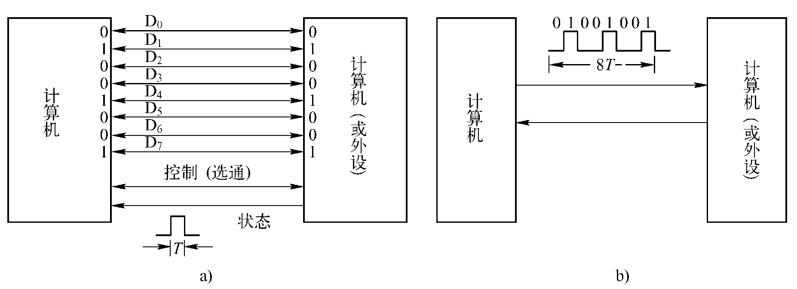
1.Concepts related to communication
Communication: The exchange of information between the CPU and external devices, as well as between computers.
Communication types: parallel and serial
Parallel communication: Transmits data in units of bytes or multiples thereof；
Transmit one (or more) bytes of data in a single transmission, with all bits sent simultaneously；
Serial communication: connected by 2 (or 3) data signal lines, data is transmitted sequentially on one data signal line, each bit of data occupies a fixed time length.
Diagram of parallel and serial communication connections

Slide 4
1. Communication-related concepts
concurrent communication
It is suitable for the exchange of information between external devices and microcomputers in a short distance, large quantity and fast. The internal bus of the computer transmits data in a parallel way.
The characteristic of parallel communication is fast transmission speed, but when the distance is far and the number of bits is large, the communication line is complex and costly.
serial communication
Compared with parallel communication, the advantages of serial communication are less transmission lines, low cost, suitable for long-distance transmission and easy to expand. The disadvantages are slow speed, long transmission time and so on.
Serial communication is commonly used for devices such as COM port devices, USB devices, and network communication in computers.

Slide 5
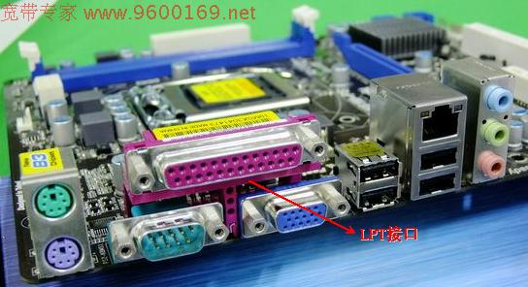
1. Concepts related to communication
USB mouth
DB25 Type LPT Parallel Printer Interface
DB9 Type COM Serial Port (RS232 Male)

Slide 6
1 Concepts related to serial communication
1. Classification of serial communication
(1) Classification by serial data synchronization method
Serial communication can be divided into two types: synchronous communication and asynchronous communication.
asynchronous communication
In asynchronous communication, the receiver and transmitter operate independently using their own clocks, functioning in a non-synchronous manner.
Data transfer is carried out in character units. The transfer between characters is completely asynchronous, and the transfer between bits is basically synchronous.
In asynchronous transmission, each character uses start and stop bits as the beginning and end of the character, and is sent and received one character at a time.

Slide 7
asynchronous communication
Format for each character in asynchronous transfer
First, a starting bit 0 is used to indicate the beginning of the character;
The character data word follows immediately after, typically consisting of 7 or 8 bits (low bits first, high bits last: D0D1D2D3D4D5D6D7). A parity bit may be added to the data word as needed.
The final stop bit 1, which can be either a single bit or two bits, completes the frame. The serial data word, along with the start and stop bits of the framing signal, forms a complete serial transmission frame (character frame).
The start bit is represented by a low logic level “0”, and the stop bit by a high logic level “1”.

Slide 8
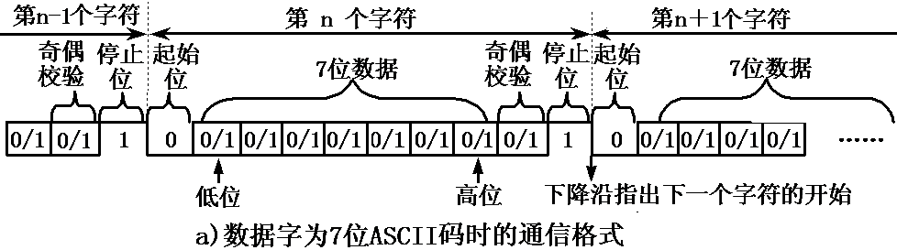
asynchronous communication
Figure a shows the 7-bit ASCII code for data characters, with the 8th bit serving as the parity bit. Together with the start and stop bits, this forms a 10-bit character frame. Once the frame signal is established, characters are transmitted sequentially.
D0 D1 D2 D3 D4 D5 D6
a) Communication format for 7-bit ASCII data characters

Slide 9
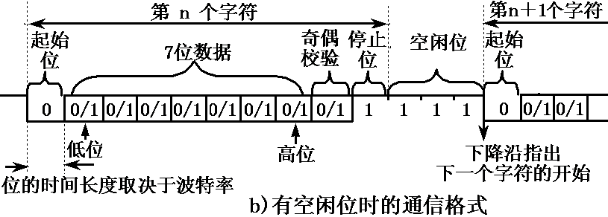
asynchronous communication
In asynchronous transmission, the character intervals are not fixed. Idle bits can be added after the stop bit, which are represented by high level and used to wait for transmission. In this way, the receiving and sending can be carried out at any time without time limit.
D0 D1 D2 D3 D4 D5 D6
b) Communication format when there is free space

Slide 10
asynchronous communication
In asynchronous data transfer, the two parties must agree on two things:
Character format: includes the encoding format of characters, parity, and start and stop bits.
Communication rate: The communication rate is usually expressed in bits per second.
Bit rate is the transmission rate of a digital signal, which is expressed by the number of valid bits (bits) of binary code transmitted per unit time;
It is expressed in bits per second (bit/s or bps), kilobits per second (Kbps), or megabits per second (Mbps).
bps： bit per second

Slide 11
asynchronous communication
Baud rate and bit rate
The baud rate refers to the modulation rate of the data signal on the carrier, which is expressed by the number of times the carrier modulation state changes per unit time, and its unit is baud (Baud).
The relationship between baud rate and bit rate is: bit rate = baud rate × number of binary bits per modulation state.
In information transmission channels, the signal units carrying data are called code elements. The number of code elements transmitted per second through the channel is called the code element transmission rate, or simply the baud rate. The baud rate is an indicator of the transmission channels frequency band (bandwidth).

Slide 12
(1) Classification by serial data synchronization method
asynchronous communication
Port rate and bit rate:
(Baidu Encyclopedia explanation of baud rate:) Baud rate refers to the transmission speed of a microcontroller or computer during serial communication. When data transmission speed is expressed in characters (frames) per second, it can be understood as the baud rate.
For example, the data transfer rate is 120 characters (frames) per second (this rate is called the baud rate, or 120 baud).
Each character frame consists of 10 bits (1 start bit, 1 stop bit, and 8 data bits), resulting in a transmission rate of 10×120=1200 bits/s (bps).
In the following description, in order to adapt to the usual usage, the bit rate and baud rate are unified to use the baud rate to represent.

Slide 15
(1) Classification by serial data synchronization method
SYCOM
Synchronous communication is a method of transmitting data in a continuous serial stream, with only one frame of information transmitted per communication session.
The information frame (data block) here differs from the character frame in asynchronous communication, typically containing multiple data characters.
That is, data transfer is carried out in blocks of data (a group of characters), with synchronization between characters and between bits within characters, without any interval.
The receiving clock is strictly synchronized with the sending clock, and a synchronization clock is usually required.
According to the control protocol, the data format is divided into character-oriented and bit-oriented.

Slide 16
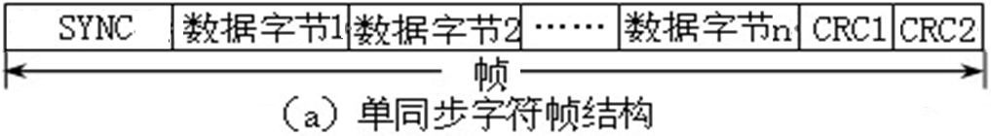
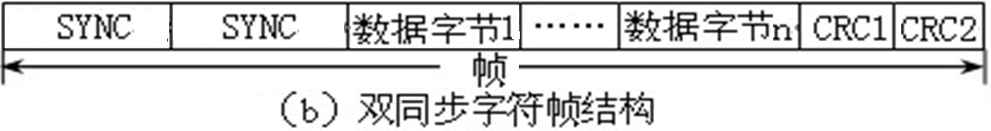
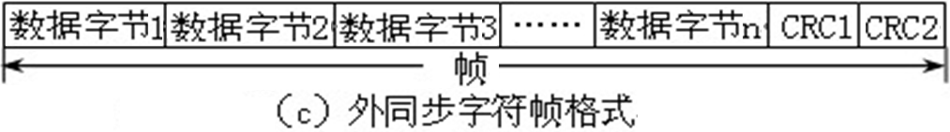
② SYCOM
(a) Character-oriented data format
The character-oriented synchronous communication data format can adopt three data formats: single synchronization, double synchronization, and external synchronization, as shown in the figure.
Sync only characters (e.g., ASCII SYN code 16H)
check character CRC
Dual synchronous character SYNC (such as the internationally recognized standard EB90H)
Use a dedicated control line to transmit the synchronization character
Character-oriented synchronous communication data format

Slide 17
② Synchronous Communication(a) Character-oriented data format
Single synchronization, double synchronization
Both single and double synchronization consist of three components: synchronization characters, data characters, and CRC (Cyclic Redundancy Check) verification characters.
Single synchronization involves transmitting a single synchronization character SYNC before data, while double synchronization requires sending two SYNC characters.
Synchronous characters may follow either a unified standard format or user-defined conventions. For single-sync characters (SYNC), the ASCII standards SYN code (16H) is commonly used, while double-sync characters (SYNC) typically employ the internationally recognized standard code EB90H.

Slide 18
② Synchronous Communication (a) Character-oriented data format
External synchronization
The external synchronous communication data format does not contain synchronization characters. Instead, a dedicated control line transmits synchronization characters to synchronize both the receiver and transmitter. Each frame ends with a two-byte cyclic redundancy check (CRC) code.

Slide 19
② Synchronous Communication (b) Bit-oriented data format
According to the Synchronous Data Link Control (SDLC), each frame of bit-oriented data consists of six parts.
The first part is the start marker "7EH (0111 1110B)";
The second part is a one-byte address field;
The third part is a one-byte control field;
The fourth part contains the data to be transmitted, which consists of bit sets.
The fifth section is a two-byte cyclic redundancy check (CRC) for loop control.
The final segment is 7EH (0111 1110B), which serves as the end marker.

Slide 20
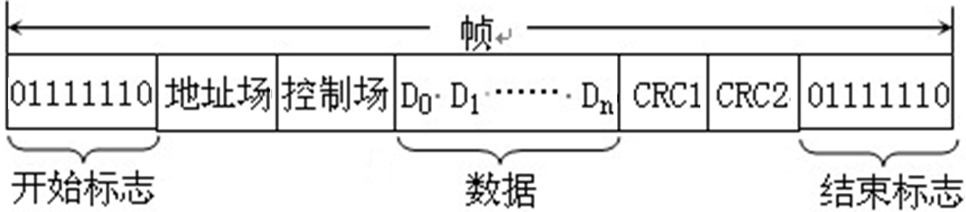
② Synchronous Communication (b) Bit-oriented data format
The data format for bit-oriented data is shown in the figure.
Bit-type synchronous communication data format
Note: The SDLC protocol prohibits the occurrence of six consecutive “1”s in either the data segment or the CRC segment, as this would be mistaken for an end-of-segment marker.
The sender is required to check. When five consecutive "1" s appear, a "0" is inserted immediately. The receiver removes the inserted "0" to restore the original data and ensure the normal communication.

Slide 21
(1) Classification by serial data synchronization method
② SYCOM
Synchronous communication advantages and disadvantages
The data transmission rate is high, usually up to 56000bps or higher, suitable for transmitting large amounts of information and high transmission rate systems.
The disadvantage is that the sending clock and the receiving clock must be kept strictly synchronized. Therefore, the sending clock should not only be consistent with the sending baud rate, but also be transmitted to the receiving end at the same time.

Slide 22
1. Classification of serial communication
(2) Classification according to data transmission direction
According to the direction of data transmission, serial communication can be divided into three modes: simplex, half-duplex and full-duplex.
Figure a illustrates a simplex communication mode (Simplex). Station A acts as the transmitter, while Station B serves as the receiver. Data transmission is unidirectional from A to B, but not vice versa.
Simplex communication is similar to radio broadcasting. The radio station sends the signal, and the radio receives the signal. The radio can never send the signal.
a) Single-channel communication mode
Point-to-point communication mode

Slide 23
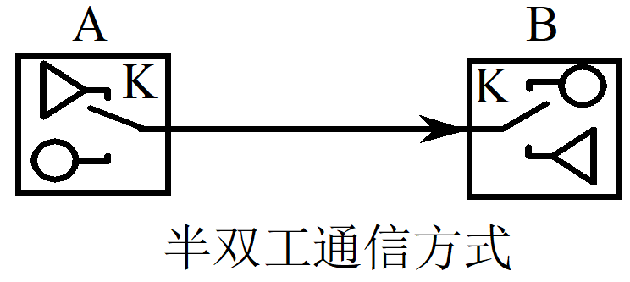
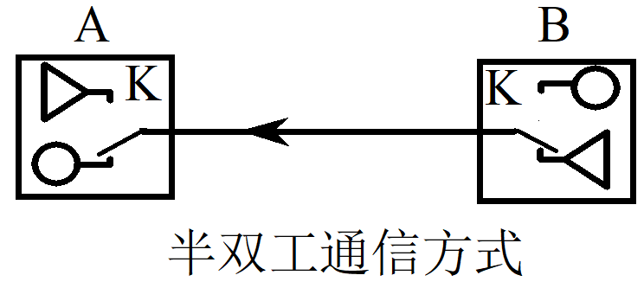
(2) Classification according to data transmission direction
Figure b illustrates the half-duplex communication mode(Half Duplex), where data can be transmitted from A to B or vice versa.
However, because it is connected by a single wire, sending and receiving cannot be done at the same time, and only one direction of transmission can be done at the same time, and the direction of transmission is controlled by the transceiver control switch K.
The half-duplex communication mode is similar to a walkie-talkie. At any given time, A sends and B receives, while B sends and A receives. Both parties cannot send and receive at the same time.
b) Half-duplex communication mode
Point-to-point communication mode

Slide 24
(2) Classification according to data transmission direction
Figure c illustrates the full-duplex communication mode (Full Duplex). In this configuration, two separate transmission lines connect the sender and receiver, allowing both A and B to transmit and receive simultaneously.
Full-duplex communication mode is similar to telephone, both parties can send and receive data at the same time.
c) Full-duplex communication mode
Figure 8-5: Point-to-point communication

Slide 25
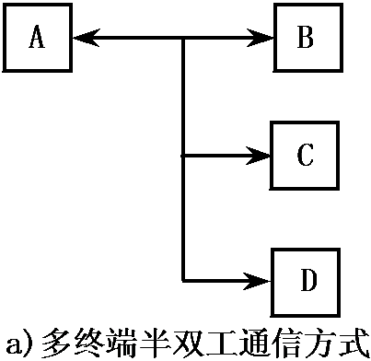
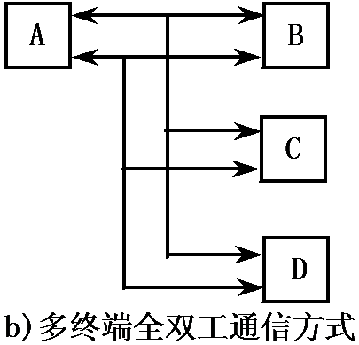
(2) Classification according to data transmission direction
The diagram illustrates a master-slave multi-terminal communication system. Device A can send messages to multiple terminals (B, C, D, etc.). Under As authorization, it can control and manage terminals B, C, D, etc., enabling them to send messages to A at different times.
It is divided into multi-terminal half-duplex communication and multi-terminal full-duplex communication.
Master-slave multi-terminal communication mode

Slide 26
1 Concepts related to serial communication
2. Serial interface
Function: In serial communication, data is transmitted bit by bit sequentially, whereas in computers, data is transmitted in parallel. Therefore, the transmitter must convert parallel data into serial format for transmission, and the serial data received by the receiver must be converted back into parallel format before being sent to the computer.
The conversion from parallel → serial → from serial to parallel can be implemented either in software or in hardware.
Since software implementation increases the CPU load, hardware (serial interface) is often used to complete this conversion.

Slide 27
2. Serial interface
The serial interface is connected to the CPU via the system bus, as shown in the figure.
Receive Shift
deposit
implement
Shift
register

Slide 28
2. Serial interface
The serial interface consists of four main components
Data input register. During the input process, serial data enters the serial interfaces receiving shift register bit by bit through the transmission line. After conversion by the serial-to-parallel circuit, the data is transferred from the receiving shift register to the data input buffer upon completion of a character reception, awaiting CPU read access.
Data output register. When the CPU outputs data, it first goes to the data output buffer. Then, the data is transferred to the output register and sent to the send shift register. After passing through the parallel-to-serial converter, the data is transmitted bit by bit through the output transmission line to the peripheral device.

Slide 29
2. Serial interface
The serial interface consists of four main components
Status register. The status register stores the operational status of peripherals. The CPU accesses this register to monitor a peripherals status, enabling it to control the peripherals operations and facilitate data exchange.
Control register. The serial interface contains a control register that stores the operating mode commands and operation commands set by the CPU for the peripheral device. The peripheral device is controlled through this register.

Slide 30
2. Serial interface
Basic working principle of serial interface
During serial transmission, the CPU transfers 8-bit parallel data to the data output register via the data bus. This data is then routed to the parallel input/serial output shift register. Under the control of the transmission clock and control circuit, the data is serially output bit by bit through the serial data output terminal.
The start and stop bits are automatically added by the serial interface during transmission. After completing a frame, the serial interface generates an interrupt request, which the CPU can then process to send the next character to the transmit buffer.

Slide 31
2. Serial interface
Basic working principle of serial interface
During serial reception, the serial interface monitors the serial data input and starts a new character reception process when a low level (start bit) is detected.
The serial interface shifts the shift register (i.e., the serial input-parallel output register) left by one bit for each bit of binary data received.
After receiving a character (byte) in succession, it sends it in parallel to the data input register and triggers an interrupt, prompting the CPU to retrieve the received character.

Slide 32
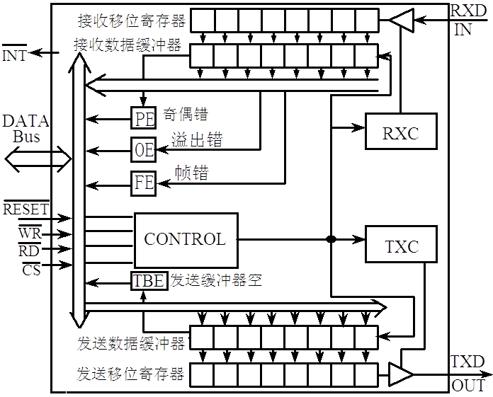
2. Serial interface
—Common chip: Universal Asynchronous Receiver/Transmitter (UART)
UART ( U niversal Asynchronous Receiver/ Transmitter
CPU
hardware
UART Structure

Slide 33
2. Serial interface
UART has three error flags:
Odd-even error, frame error, overflow (lost) error，parity error.
To detect transmission errors, UART checks the count of 1s in each character during transmission. It automatically adds a 1 or 0 to the parity bit to ensure the total 1s (including the parity bit) equals an even number for even parity and an odd number for odd parity.
During reception, the UART examines each bit of the character (including the parity bit) and verifies that the total count of 1s meets the parity check requirements to detect transmission errors.

Slide 34
2. Serial interface
UART has three error flags:
Frame error indicates that the character format does not comply with the specified requirements.
Although the clocks of the receiving and transmitting ends are not directly connected, the receiving end always repositions at the beginning bit of each character, so it is necessary to ensure that each sample corresponds to a data bit.
If the frequency difference between the receiving clock and the transmitting clock is too large, the sampling will be offset after a few samples after the start bit, resulting in receiving errors caused by sampling.
In such cases, the stop bit (which should be high according to the standard) may be low (not every stop bit is necessarily low in this scenario), resulting in frame format errors and setting the frame error flag (FE).
 | 0 | 1 | 0 | 0 | 0 | 1 | 0 | 0 | 0 | 0
stop bit
receive
transmit by radio
 | 0 | 1 | 0 | 0 | 1 | 0 | 0 | 0 | 0 | 1
start bit
stop bit

Slide 35
2. Serial interface
Receive Pin
Serial Input-Parallel Output Register
(Receive shift register)
Character 2
First character
receive data buffer
CPU a slight pause in reading
Three error flags of UART:
The Overrun error (also known as loss error) occurs when the UARTs dual-buffer structure fails to synchronize. Upon detecting the first character, the receiver immediately loads it into its data buffer while simultaneously receiving the second character from the RXD line, while awaiting the CPU to retrieve the first character from the buffer.
If the CPU is too busy to retrieve the first character, the second character received may enter the receiver buffer, causing the first character to be lost and triggering an overflow error. In such cases, the UART automatically sets the overflow error flag (OE).

Slide 36
8.1.2 Related Concepts in Parallel Communication
1. Parallel interface
Definition: An interface circuit for implementing parallel communication.
Category: Input parallel interface, output parallel interface, and input/output parallel interface.
Parallel communication is transmitted in a synchronous manner, which is characterized by fast transmission speed, large hardware overhead, and suitable for short-distance transmission.
8-bit
8-bit

Slide 37
1. Parallel interface
The parallel interface transmits status information, control information, and data information.
Status information: This indicates the current operational state of a peripheral device. For example, the READY signal (HIGH) means the input interface is ready to exchange data with the CPU, while the BUSY signal (HIGH) indicates the interface is transmitting data, requiring the CPU to wait.
Control information: The control information is sent by the CPU to control the working mode of the peripheral interface and the startup and reset of the peripheral.
Data information: The main content of the CPU and parallel interface exchange.

Slide 38
1. Parallel interface
The typical parallel interface and its connection to the CPU and peripherals are shown in the figure.
cancel
Data input is ready
Data Entry Response
8-bit
8-bit
Data output response
Enable signal
Typical parallel interface circuit diagram

Slide 39
2. Related concepts in parallel communication
2. Parallel interface circuit composition
Input buffer register. The primary function of the input data buffer is to receive data from devices. The CPU performs a read operation by executing the IN MOVX A, @DPTR instruction, which retrieves data from the input buffer.
Output buffer register. The output data buffer is primarily responsible for receiving data from the CPU. When the device is idle, it retrieves data from the buffer and notifies the CPU for the next output operation.

Slide 40
2. Related concepts in parallel communication
2. Parallel interface circuit composition
Status register. The status register stores the operational status of peripherals. The CPU accesses the status register to monitor peripheral status and control their operation.
Control register. The parallel interface contains a control register that stores the working mode commands and operation commands set by the CPU for the peripheral device. The peripheral devices operation is controlled through this register.
Data information. The main content of the CPU and parallel interface exchange.

Slide 41
2. Related concepts in parallel communication
3. Basic input/output operation of parallel communication interface
(1) Input process
The peripheral device first places the parallel data on the data bus between the peripheral device and the interface, and enables the "data input ready" status select signal, which enables the data to be input into the input data buffer of the interface.
When data is written to the input data buffer, the interface activates the Data Input Acknowledgment signal, indicating that the peripheral data has been received, as a response to the peripheral input.
After receiving this signal, the peripheral device cancels the input data and the "Data Input Ready" signal.

Slide 42
(1) Input process
When data arrives at the interface, it sets the input ready status bit to 1 in the status register (indicating the input buffer is full) for CPU polling. The interface may also send an interrupt request to the CPU at this point, signaling that data has been received.
The CPU can access interface data either through query programs or program interrupts.
After the CPU reads data from the input buffer, the interface automatically clears the input ready status bit in the status register to 0 (indicating the input buffer is empty) and sets the data bus to high-impedance state. This completes the data transfer.

Slide 43
3. Basic input/output operation of parallel communication interface
(2) Output process
When a peripheral device retrieves data from the interfaces output buffer register, the interface sets the Output Ready status bit (1) in the status register. This indicates that the CPU can now send data to the interface, and the CPU can check this status bit.
The interface can also send interrupt requests to the CPU at this time. The CPU can output data to the interface either through a query program or a program interrupt.

Slide 44
3. Basic input/output operation of parallel communication interface
(2) Output process
When the CPU sends data to the output buffer, the interface automatically clears the output ready status bit to 0 (indicating the buffer is full) and transfers the data to the peripherals data line. Simultaneously, it sends a start (select) signal to activate the peripherals data reception.
After the peripheral device starts, it begins receiving data and sends a data output response (data ready) signal to the interface (from the pin, indicating that the peripheral device has retrieved the data and the interface can transmit data to the peripheral device).
The interface receives this signal and sets the Output Ready status in the status register position 1, (indicating the output buffer is empty), allowing the CPU to send the next data to the buffer.

Slide 45
2 Serial Interface
The buffer also acts as an output shift register
2.1 Microcontroller Serial Interface
The IAP15W4K58 S4 microcontroller features four full-duplex serial communication interfaces (UART 1, UART 2, UART 3, and UART 4).
Each serial port consists of two data buffers, one (input) shift register, one serial control register, and a baud rate generator.
The data buffer of each serial port consists of a serial receive buffer and a transmit buffer, which are physically independent and can receive and transmit data, and can transmit and receive data simultaneously.
The receive buffer can only read, not write, while the send buffer can only write, not read. They share the same address number.
sfr SBUF = 0x99; // Serial Port 1 Data Register
sfr S2BUF=0x9B; // Serial Port 2 Data Register
sfr S3BUF=0xAD; // Serial Port 3 Data Register
sfr S4BUF=0x85; // Serial Port 4 Data Register

Slide 46
2.2 RS232 Serial Communication Interface
In the computer-centered data acquisition and control system, it is usually necessary to use the microcontroller to collect data, and then send the data to the computer by asynchronous serial communication;
The control command to be completed is sent to the microcontroller by the computer through serial communication, and the microcontroller controls it.
Serial communication between computers and microcontrollers typically utilizes RS-232 or RS-485 bus standard interfaces. This article presents a design methodology for RS-232 interface serial communication.

Slide 47
USB mouth
DB25 Type LPT Parallel Printer Interface
DB9 Type COM Serial Port (RS232 Male)

Slide 48
2.2 RS232 Serial Communication Interface
RS-232
It is an early standard for data communication in public telephone networks.
Its logic levels differ entirely from those of TTL/CMOS. The logic 0 is defined as +5 to +15V, while the logic 1 is defined as-5 to-15V.
Because there is a common ground between RS-232 sending and receiving, and the transmission is in unbalanced mode, common mode noise is coupled into the signal system. The maximum communication distance recommended by the standard is 15 meters.
1. Hardware interface design
The computer serial port operates at RS-232 level, while the microcontroller serial port uses TTL level. Therefore, a circuit is required to convert between TTL and RS-232 levels.
The most widely used level conversion chip is MAX232 (or compatible chips like SP3232), which operates on a single +5V power supply, with RS232 voltage generated by an internal charge pump.

Slide 49
1. Hardware interface design
The SP3232 conversion chip converts the microcontrollers two serial ports into two RS-232 interfaces, enabling direct serial communication between the microcontroller and computers.
Hardware interface for RS-232 conversion chip SP-3232 with microcontroller

Slide 50
1. Hardware interface design
Modern personal computers, especially laptops, no longer have DB9 serial ports, while USB ports are more prevalent. In such cases, we can use USB-to-serial converters to bridge the gap.
Common USB-to-serial port chips include CH340T and CP210x. The interface circuit between CH340 and the microcontroller is shown in Figure 4-28.
The USB-to-serial port circuit only converts between the USB and UART protocols. For users, there is no fundamental change in programming, as it functions like a standard serial port.
The only thing to note is that when programming a serial port on a computer, the serial port number should be selected correctly.

Slide 51
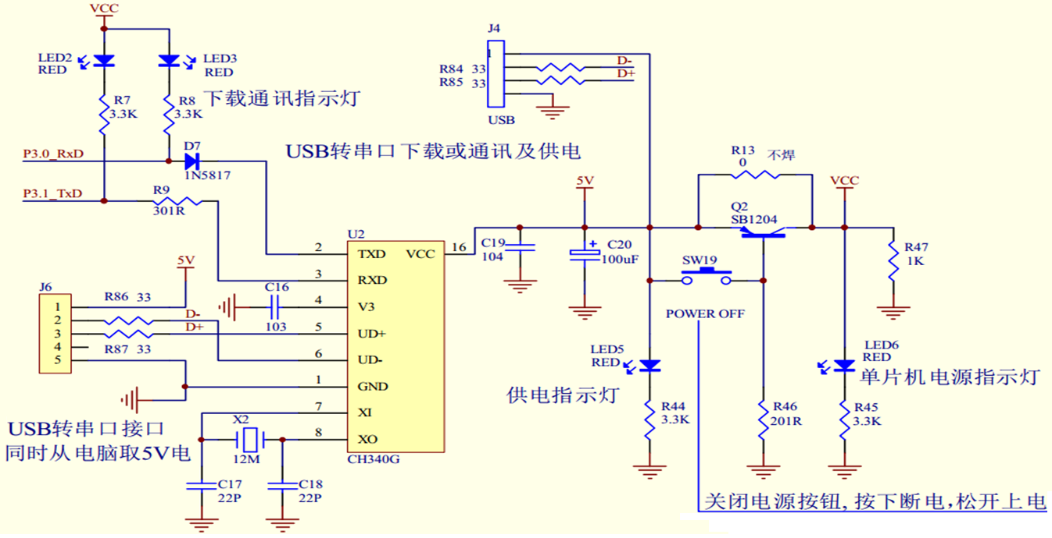
Schematic diagram of USB to serial port download, communication, and power supply circuit
(1) Hardware configuration: The system employs a single CPU for both processing and simulation. The computer connects to the microcontroller via a USB-to-UART interface. The integrated conversion circuitry is shown in Figure 4-28.
CH340 converts USB to UART. Connect the computers USB port using J4 or J6.
2SB1204: PNP High-current Switching Transistor

Slide 52
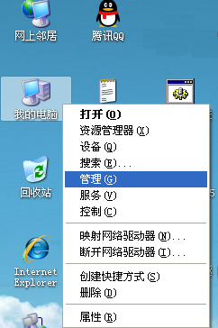
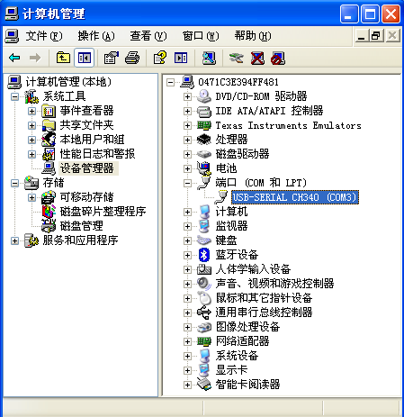
1. Hardware interface design
When programming a serial port on a computer, the serial port number must be selected correctly.
Serial number
How to find a search port number

Slide 53
The interface circuit between CH340T and the microcontroller is shown in the figure.
CH340T interface circuit with microcontroller

Slide 54
2.2 RS232 Serial Communication Interface
RS-232 conversion interface
computer
singlechip
2. Software Design
Software design often varies according to the requirements of the application system. Software design is divided into two parts: supercomputer program design and microcontroller program design.
If the sole purpose is to verify the serial port circuit connection and the correctness of the microcontroller communication program design, the host computer program can directly utilize the ready-made STC-ISP serial port debugging assistant software.
STC-ISP software is available for download from http://www.stcmcu.com
Of course, you can also design it yourself using a visual development environment like Visual C++.
or USB conversion interface

Slide 55
2.2 RS232 Serial Communication Interface [Example]
This article demonstrates the hardware interface design and software implementation for RS232 communication between a computer and a microcontroller through a practical example.
[Example] The computer sends a data to the microcontroller. After receiving the data, the microcontroller takes the received data by bit inversion and sends it back to the computer.
Assuming the microcontrollers system clock is 11.0592MHz, the communication parameters are "9600, n, 8, 1" (a common communication parameter format: baud rate 9600 bit/s, no parity (n: none) (or E: Even, O: Odd), 8 data bits, 1 stop bit).
Display data sent from a microcontroller on a computer. In this case, the computer is usually called a host computer.

Slide 56
[Example] The computer sends data to the microcontroller, which inverts the data and returns it to the computer.
In the following microcontroller programming, when communicating with a host computer through the serial port 2 of the IAP15W4K58S4 microcontroller, Timer 2 must be selected as the baud rate generator.
If serial port 1 is used for communication, you can choose timer 1 or timer 2 as the baud rate generator. The program design method is similar, so readers can experiment on their own.

Slide 57
2.3 RS485 serial communication interface
The RS-485 serial data interface was developed to overcome the limitations of RS-232, including its short communication range (15 meters) and low data rate.
The standard based on RS-422 adds the ability of multi-point and two-way communication, that is, allowing multiple transmitters to be connected to the same bus, and adding the drive capability and conflict protection characteristics of transmitters.
The RS-485 standard only specifies the electrical characteristics of the balanced transmitter and receiver, but does not specify the connector, transmission cable, and application layer communication protocol.

Slide 58
2.3 RS485 serial communication interface
The RS-485 data signal employs differential transmission, also known as balanced transmission. It uses a pair of twisted wires, with one designated as A and the other as B.
The positive voltage range between A and B (A-B) is +2V to +6V, representing the logic state 1; the negative voltage range is-2V to-6V, representing the logic state 0.
The RS-485 standard has a maximum transmission distance of approximately 1200 meters and a maximum transmission rate of 10Mbps.

Slide 59
2.3 RS485 serial communication interface
The RS-485 network uses balanced twisted pair as the transmission medium. The length of the balanced twisted pair is inversely proportional to the transmission rate. Only when the rate is below 20 kbps can the specified maximum cable length be used. The maximum transmission rate can only be obtained at very short distances.
Generally, the maximum transmission rate of a 100-meter twisted pair cable is only 1Mbps. If optical isolation is used, the communication rate is also limited by the response speed of the optical isolation device.

Slide 60
2.3 RS485 serial communication interface
Using RS-485 standard, a relatively economical communication platform with high noise suppression and high transmission rate can be established, which has the advantages of long transmission distance, wide common mode range and convenient control.
At present, RS-485 half-duplex asynchronous communication bus is widely used in the field network of engineering application to communicate between centralized control hub and decentralized control unit.

Slide 61
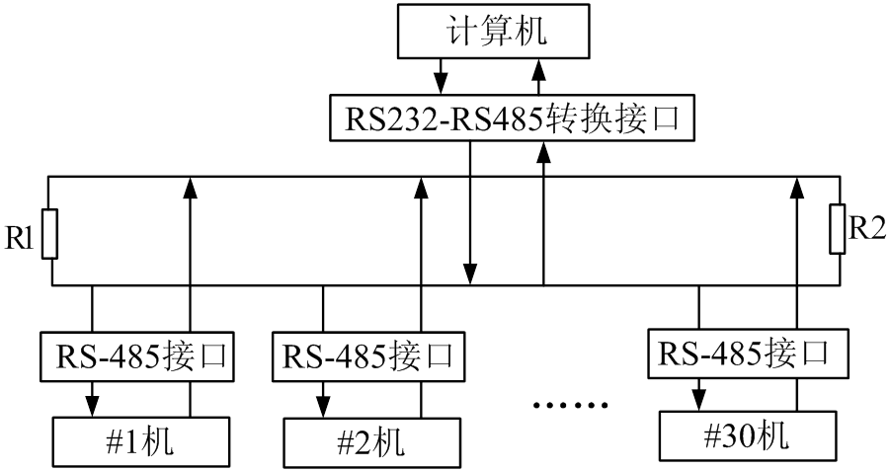
2.3 RS485 serial communication interface
The system architecture is shown in the figure, with a computer as the host and connected to the field control unit through RS-485.
Master-slave architecture diagram of RS-485 network

Slide 62
2.3 RS485 serial communication interface
The RS-485 interface chip supports half-duplex transmission, such as the MAX3082 (or other RS-485 chips like MAX485 or MAX487).
The MAX3082s architecture and a typical half-duplex communication circuit diagram are shown in the figure.
When receiving data, the microcontroller should clear P1.0 to 0; when sending data, it should set P1.0 to 1.
A: The positive terminal of the 485 differential signal;
B: The reverse terminal of the 485 differential signal;
VCC: Power supply terminal;
GND: Ground terminal.
RE: The receiving end is valid only at low level;
DE: Send high-level signal to enable terminal;
RO: TTL-level output for receiving data;
DI: TTL-level data input terminal for data transmission;
(A-B)>-0.05v, RO=1
(A-B)<-0.2v, RO=0
The MAX3082s architecture and a typical half-duplex communication circuit diagram

Slide 63
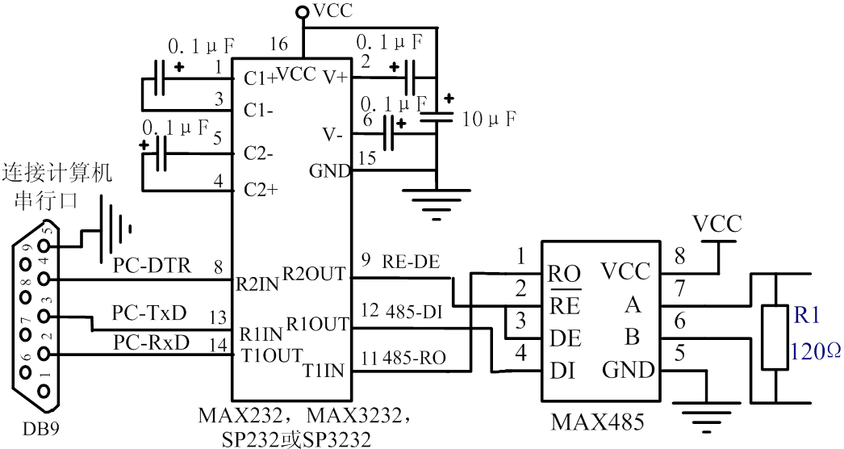
2.3 RS485 serial communication interface
The computers RS-232 and RS-485 conversion circuitry is shown in the figure.
The pins of the 8-pin MAX485 are identical to those of the MAX3082.
(A-B)> 0.2v, RO=1
(A-B)<-0.2v, RO=0
RS-232 and RS-485 conversion circuit for connecting computers
MAX485

Slide 64
2.4 SPI Communication Interface
1. Introduction to SPI Interface
The IAP15W4K58S4 incorporates a S erial P eripheral I nterface (SPI).
The SPI interface supports both communication with other microprocessors and synchronous interaction with SPI-compatible devices such as memory modules, A/D converters, D/A converters, LED drivers, and LCD drivers.
SPI interface has two operating modes: master mode and slave mode

Slide 65
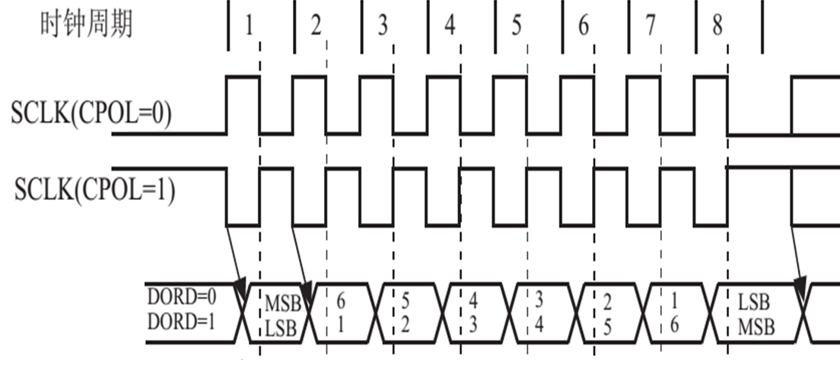
3. SPI interface data communication
(Host output)
MOSI
(From the slave input)
data format

Slide 66
2. Architecture of the SPI interface in the IAP15W4K58S4 microcontroller
:SO
(STC15W:4,8,16,32 )
STC15F/L
Send buffer register SPDAT
:MI
:MO
:SI
SPDAT
SPI permit
/SS: Slave Select
SPSTAT
SPCTL

Slide 67
Technical specifications for the SPI interface of the IAP15W4K58S4 microcontroller
The SPI core consists of an 8-bit shift register and a data buffer, enabling simultaneous data transmission and reception. During SPI data transfer, both transmitted and received data are stored in the buffer.
In master mode, to send a byte of data, simply write the data to the SPDAT register. The /SS signal is not required in master mode.
In slave mode, data transmission can only occur after the /SS signal becomes active and receives a valid clock signal. When a byte is transmitted, if the /SS signal transitions to high level, the hardware logic immediately marks the byte as received and prepares the SPI interface for the next data reception.
Any change to the SPI control register will reset the SPI interface and clear the relevant registers.

Slide 68
3. SPI interface data communication
(1) SPI interface signal
The SPI interface consists of four signal lines: MISO/P1.4, MOSI/P1.3, SCLK/P1.5, and /SS/P1.2. The SPI interface pins can be switched.
MOSI (Master Out Slave In, master output slave input)
The output of the master device and the input of the slave device are used for serial data transmission from the master device to the slave device.
According to the SPI specification, multiple slaves share a MOSI signal line.
During the first half of the clock cycle, the master places data on the MOSI line, and the slave retrieves it at this boundary.

Slide 69
(1) SPI interface signal
MISO (Master In Slave Out, Master Input Slave Output)
From the slave device to the master device. Used to transfer data from the slave device to the master device.
In the SPI standard, a host can connect to multiple slaves. Therefore, the hosts MISO signal line is shared among these slaves, meaning they all use the same MISO line.
When the master communicates with a slave, the other slaves should drive their MISO pins to a high-impedance state.
SSIG=0
(8-bit shift register)
(SPI clock generator)
SSIG=0

Slide 70
(1) SPI interface signal
SCLK (SPI Clock, Serial Clock Signal)
The serial clock signal serves as the output of the master device and the input of the slave device, synchronizing serial data transfer between them over the MOSI and MISO lines.
When the master device initiates a data transfer, it automatically generates 8 SCLK clock cycles to the slave device. Each SCLK transition (rising or falling edge) carries out one bit of data.
One byte of data can be transferred in a single data transfer.
SSIG=0
SSIG=0

Slide 71
(1) SPI interface signal
SCLK, MOSI, and MISO are typically used to connect two or more SPI devices.
Data is transmitted from the host to the slave via MOSI and from the slave to the host via MISO.
The SCLK signal is an output in master mode and an input in slave mode.
When the SPI interface is disabled (i.e., SPCTLs SPEN register is set to 0), these pins can be used as I/O ports.

Slide 72
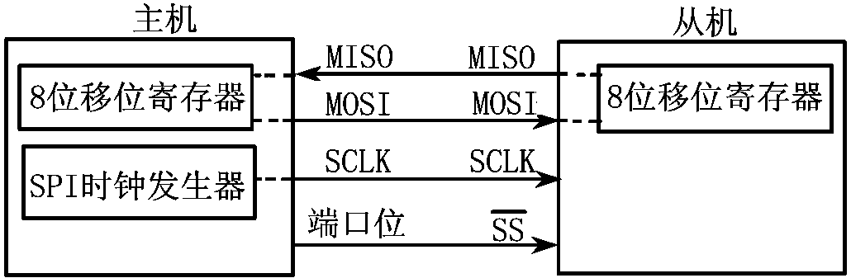
(1) SPI interface signal
(Slave Select, slave device selection signal)
This is an input signal used by the master device to select the SPI module in slave mode.
In master mode, the SPI interface functions as a single host (only one host is permitted), eliminating the need for host selection. The /SS pin is not required in this mode. Typically, the hosts /SS pin is pulled up to a high level through a 10kΩ resistor. Each slaves /SS pin connects to the hosts I/O port, with the host controlling the pins voltage level to select the slave.
In slave mode, the /SS signal must be active for both sending and receiving. Therefore, the /SS signal must be pulled low before initiating data transfer. The SPI master can select a SPI device (set /SS=0) as the current slave through its I/O port.

Slide 73
3. SPI interface data communication
(2) SPI interface data communication method
The IAP15W4K58S4 microcontroller supports three SPI interface data communication modes:
Single master-single slave
Dual-device mode (devices can act as hosts or slaves)
Single master, multiple slaves.
1) Single master-slave configuration
The connection is shown in the figure.

Slide 74
1) Single master-slave configuration
In the diagram, the slave SSIG (SPCTL.7) is set to 0 and not ignored , which is used to select the slave.
The SPI host can control the slaves pins using any port bit (including P1.2/ ).
SPI interface single master-slave connection
Set as output mode P1.2/
or P1.5 pins
SPCTL register | D7 | D6 | D5 | D4 | D3 | D2 | D1 | D0
 | SSIG | SPEN | DORD | MSTR | CPOL | CPHA | SPR1 | SPR0

Slide 75
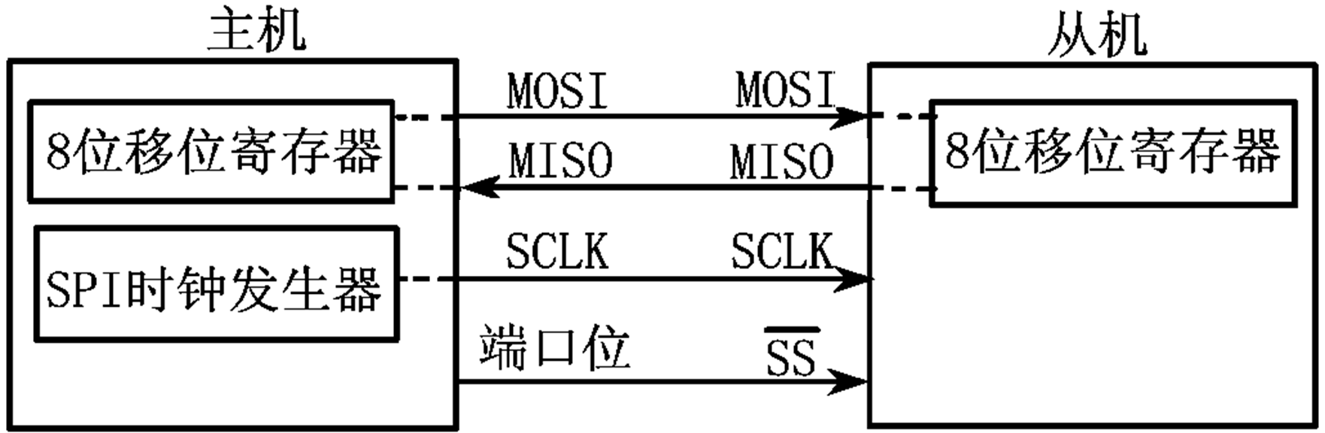
1) Single master-slave configuration
The 8-bit shift registers of the master SPI and slave SPI are interconnected to form a 16-bit shift register.
When the host writes a byte to SPDAT, it initiates an 8-bit shift communication process: The hosts SCLK pin sends a series of pulses to the slaves SCLK pin. Under the pulse-driven operation, data from the hosts SPI 8-bit shift register is transferred to the slaves SPI 8-bit shift register, while data from the slaves SPI 8-bit shift register is transferred to the hosts SPI 8-bit shift register. This enables the host to both send data to the slave and read data from the slave.
D7 | D6 | D5 | D4 | D3 | D2 | D1 | D0
D7 | D6 | D5 | D4 | D3 | D2 | D1 | D0

Slide 76
(2) SPI interface data communication method
2) Dual device mode
The two-device mode, also known as the master-slave mode, is connected as shown in the figure.
SPI interface dual-device connection

Slide 77
2) Dual device mode
In the diagram, the two devices can function as master-slave pairs. When no SPI operation is active, both devices can be configured as masters (MSTR=1), with SSIG cleared and P1.2 ( ) set to either quasi-dual mode or input mode. When one device initiates transmission, P1.2 can be configured as an output and driven to a low level, thereby forcing the other device to become a slave.

Slide 78
(2) SPI interface data communication method
3) Single master-multiple slaves
In the diagram, the slaves SSIG (SPCTL.7) is set to 0, enabling the slave to be selected via the corresponding /SS signal. The SPI master can control the slaves /SS using any port bit (including P1.2/SS).
SSIG=0
SSIG=0
SPI interface single master multi slave connection

Slide 79
(3) SPI interface data communication process
In SPI communication, data transmission is always initiated by the host. When SPI is enabled (SPEN=1), the hosts write operation to the SPI data register activates the SPI clock generator and data transfer. Half to one SPI bit time after the data is written to SPDAT, the data appears on the MOSI pin.
Note that the host can communicate with the slave by driving the corresponding devices /SS pin to a low level. Data written to the hosts SPDAT register is transferred from the MOSI pin to the slaves MOSI pin, while data from the slaves SPDAT register is sent from the MISO pin to the hosts MISO pin.
D7 | D6 | D5 | D4 | D3 | D2 | D1 | D0
D7 | D6 | D5 | D4 | D3 | D2 | D1 | D0
The two shift registers in the host and slave CPUs can be viewed as a 16-bit cyclic shift register. As data shifts from the host to the slave, it simultaneously enters in the opposite direction. This means that during one shift cycle, the data between the host and slave are exchanged.

Slide 80
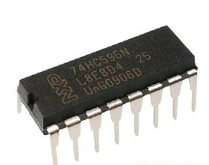
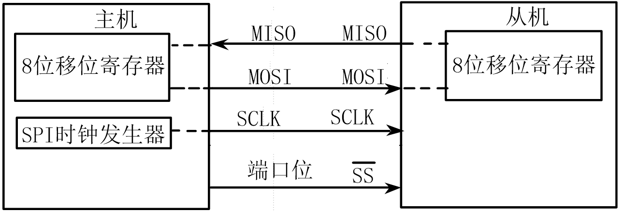
74HC595 interface and its application
The following example demonstrates SPI interface usage with a master-slave communication configuration. The IAP15W4K58S4 microcontroller sends data to the 74HC595 shift register, driving the LED display.
The 74HC595 is a serial-to-parallel converter (8-bit tri-state shift register/output latch) developed for Motorolas SPI bus.
The 74HC595 is widely used for I/O port expansion in MCUs (microcontrollers) and MPUs (microprocessors) due to its compatibility with TTL, NMOS, and CMOS input/output levels, as well as its strong output load capacity.
//
P4.0
SI
P4.3
SCK
Two shift registers can be thought of as
A 16-bit cyclic shift register
The 74HC595 does not need to send data to the host
/ P5.4
RCK

Slide 81
74HC595 Interface and Its Applications
The 74HC595 operates at 30MHz clock speed with 5V power supply, and each parallel output port can handle 20mA sink and source currents. This feature enables easy LED driving without requiring additional current amplification circuits.
Its input terminal allows 500nS rising (falling) time, and can still detect severely distorted clock pulses.
In this way, the larger transmission line capacitance to ground can be accommodated, so that the systems anti-interference ability is enhanced.

Slide 82
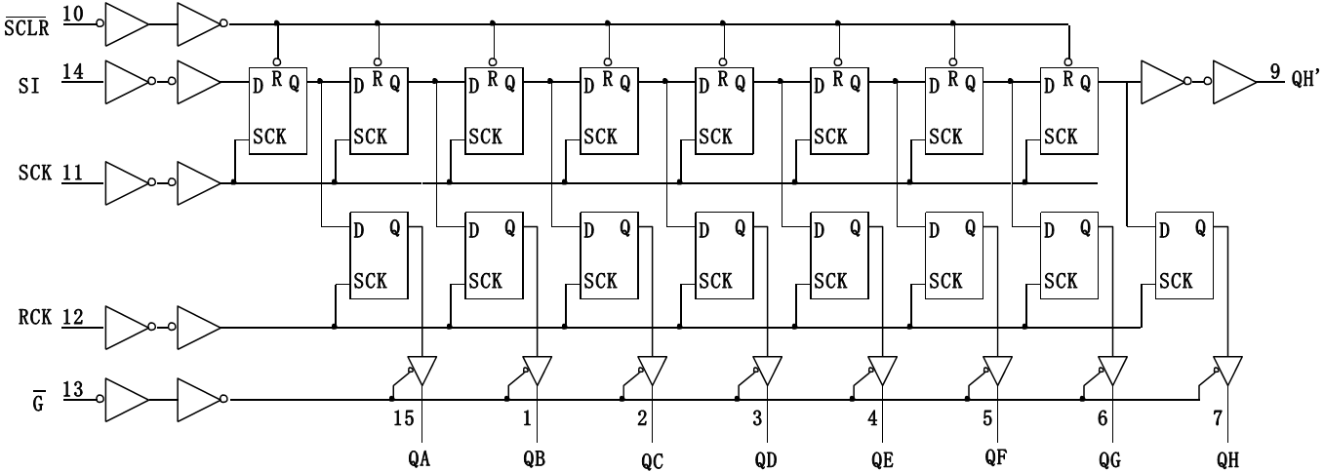
74HC595 Interface and Its Applications
shifter
Shift Clock
Clock latch
latch
Control three-state output
74HC595 logic circuit diagram

Slide 83
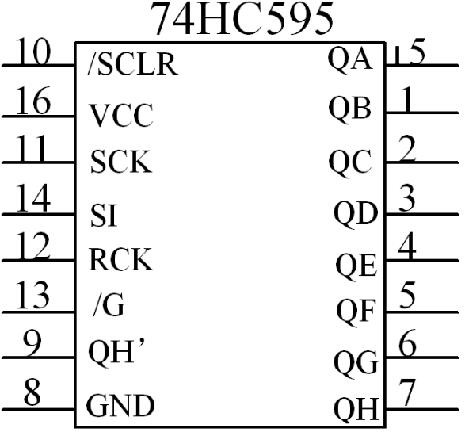
74HC595 Interface and Its Applications
The pin functions of the 74HC595 are described as follows:
SI: Serial data input, where data is transferred from this pin to the internal 8-bit serial shift register.
SCK: Shift register clock input: rising edge. Data shifts from QA to QB, then QC, and so on to QH. The register data remains unchanged during the falling edge.
(Pulse width: greater than tens of nanoseconds is sufficient at 5V.)
QH: Serial data output for cascading. No three-state output function.
QA~QH: Latch parallel data output, three states
/G: Output enable control terminal. Low level active, maps the latch output to the output parallel port (QA-QH). When the input is high, it is in high-impedance state.

Slide 84
74HC595 Interface and Its Applications
RCK: The data from the shift register enters the data latch register (latch) during the rising edge of the clock input. The latch register data remains unchanged during the falling edge. Typically, RCK is set to a low level.
After the shift is complete, a positive pulse is generated at the RCK terminal (when powered by 5V, a pulse duration of tens of nanoseconds or more is sufficient) to update the output data.
SCLR: Shift register reset input. Low level effective. When this pin is low, it resets the internal shift register (clear 0), but does not affect the 8-bit latch value. Typically, it can be connected to Vcc during operation.
GND: Ground
VCC: Power supply positive, typically 5VDC.
QA QB QC QD QE QF QG QH
MOS shift register
latch
QA QB QC QD QE QF QG QH

Slide 85
2.5 I ² C Communication Interface
1. Introduction to I2C Bus
The I2C (Inter-Integrated Circuit) bus is a serial bus developed by PHILIPS for connecting microcontrollers and their peripheral devices.
The I2C bus was developed in the 1980s for audio and video devices and is now primarily used in server management, including communication of individual component states.
For example, administrators can query each component to manage system configuration or monitor component status, such as power supply and system fan. They can monitor multiple parameters such as memory, hard disk, network, and system temperature at any time, which increases system security and facilitates management.

